Slide 1
Using international soccer tournaments to understand the education production function
- Robert Metcalfe, Simon Burgess, & Steven Proud
ECMT 677 | Referee Report | 11/18/13
Xirong Chen
Han “John” Park

Slide 2
1. Introduction
(1) RESEARCH QEUSTION
Does studying hard pay off?
  Why is this question important?
    Understanding the factors of education production function.
      Effort in studying is one of the few factors under student’s own control.

Slide 3
1. introduction
(2) BACKGROUND
Compulsory Education in England
  Key Stage 1 (KS1) : age 5 – age 7
  Key Stage 2 (KS2) : age 7 – age11
  Key Stage 3 (KS3) : age 11 – age 14
  Key Stage 4 (KS4) : age 14 - age 16
The KS4 exams at age 16 are the high stakes examinations (GCSEs)
  Crucial for continuing in school or looking for jobs

Slide 4
1. iNTRODUCTION
(2) BACKGROUND
The Soccer tournaments
  The world’s two most widely watched international soccer tournaments overlap with the exam period in schools in England.
    The FIFA World Cup (2002 & 2006)
    The UEFA European Championship (2004 & 2008)
  England is a nation known to be obsessed with soccer
  The English national soccer team were qualified in 2002, 2004, 2006, but not in 2008

Slide 5
1. introduction
(3) LITERATURE REVIEW
Lindo (2012)
  How college students are impacted in their exams when college football team is doing well.
Stinebricker (2008)
  Rooming with the video game funs will reduce the studying time.

Slide 6
2. Identification assumptions & strategy
(1) ASSUMPTION
The increasing leisure value will decrease the effort on study, and the soccer tournaments, defined as the treatment, substantially raise the leisure time value during the overlap time of exams and tournaments.

Slide 7
2. Identification assumptions & strategy
(2) STRATEGY
The authors used a sharp, exogenous, and repeated change in the value of leisure time to identify the impact of student effort on educational achievement.

Slide 8
3. data
(1) RESOURCES
Timing of soccer tournaments and exams
  Appendix Table 1 & Table 2 in the next slides
Pupil data
  National Pupil Database (NPD; state-maintained system) available to researchers by the Department for Education
Television viewing data
  The Broadcasters’ Audience Research Board (www.barb.co.uk) provides weekly data on the viewing figures of the top 30 programes per channel.

Slide 9
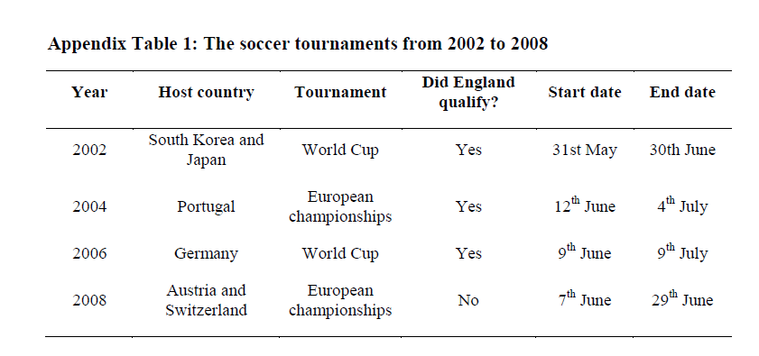
3. DATA
* Timing of soccer tournaments and exams

Slide 10
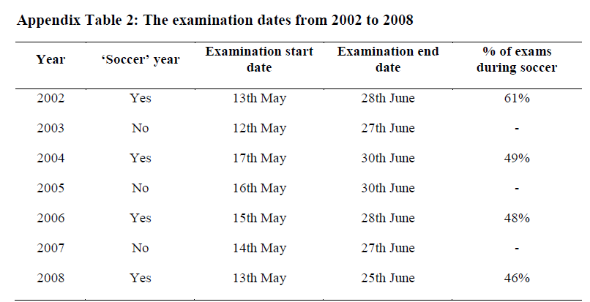
3. data
* Timing of soccer tournaments and exams

Slide 11
3. data
(2) ESTIMATION
The authors implemented a difference-in-difference framework
  to compare within-student variation in performance during the exam period between tournament and non-tournament years using seven years (2002-2008) of student-subject data on almost all the students in England.
  Non-tournament years are control years.
  Tournament years are treatment years.

Slide 12
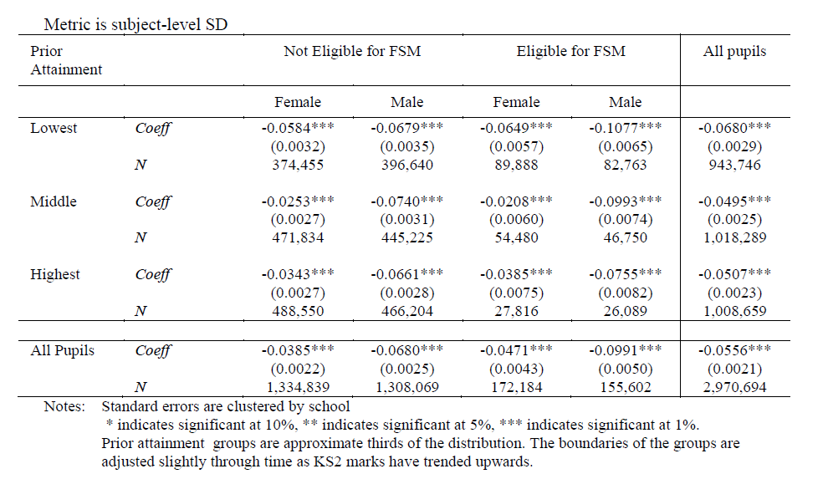
4. results
Group Diff-in-diff
comments
The average over all students in the group of their score in late exams in tournament years minus the mean score in early exams in tournament years, relative to the same calculation for non-tournament years.
The pattern across groups show bigger effects for boys than girls, bigger effects for disadvantaged groups, and a u-shape in ability, with the least effect in the middle group.

Slide 13
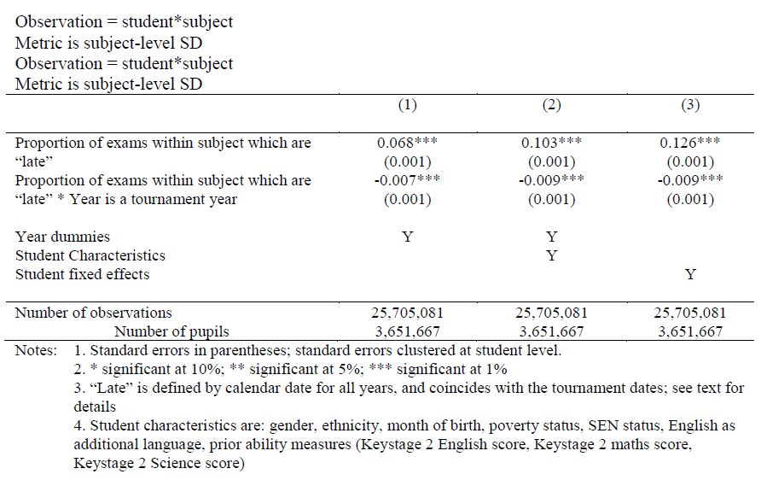
4. results
Student*subject fixed effect regression
comments
(1) Year dummies
(2) year dummies plus individual characteristics
(3) year dummies and student fixed effects
Clustered std. dev. At the individual level
Typically students do better in later exams than earlier ones.
The interaction variable shows a negative effect and is precisely determined.

Slide 14
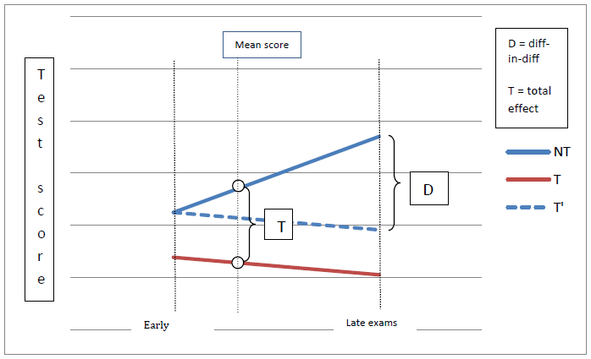
4. results
Comparing the diff-in-diff and the total effect
comments
The difference in the late-early difference between tournament and non-tournament years
Overall effect
NT: control
T: assumed counterfactual
Dash-T: true counterfactual
D: true treatment effect

Slide 15
5. conclusion
Results
They found a significant negative average effect of the tournament on exam performance, substantial for particular groups: the average impact of a fall in effort is .12 standard deviations of student performance.
Highly affected groups are (1) low ability (2) male students from (3) disadvantaged families.
They assume this impact arises through a reduction in student effort, with study time being allocated to watching the soccer tournament.
The variation in impact derives from differing tastes for soccer, arising in turn from cultural norms and idiosyncratic factors, and from the differential effectiveness of an hour of study on exam performance.
Their results show that having important exams during the tournament period reduces educational attainment; therefore, they argue that the benefits of moving the exams just a few weeks earlier in tournament years may well be significant.
Their results implies that student effort plays a prominent role in the education production function.

Slide 16
6. Main Comments
Introduction
  Within-student variation
Identification Strategy
  Variables: bad weather, Olympic games, downturn of economy, private/public school, or regional dummies
  Assumption: sports event period -> not studying
Estimation
  Dependent variable unit (std. dev.): ambiguous
  World cup and UEFA: treated in a same way
  Their first trial: overall diff-in-diff is insignificant
  Late/early for untreated years: ambiguous
Results
  Moving GCSEs: should be more careful, monetary issue transient? What about a shortened period time for all of the students? National competitiveness in England

Slide 17
6. Main Comments (cont.)
Identification Assumption
  The authors assume the increasing leisure value will decrease the effort on study. I would suggest the authors to have some solid behavior theory to back up their identification assumption.
Data
  The authors use the television viewing data to analyze the tournaments coverage. This is a good instruments. However, why do not they include the internet viewing data? They target at young children.
Robustness Check
  I think the authors should add an outlier test portion to their robustness check. For example, some super smart students can study way less than normal students to do well on the test. Also, some students probably study very hard ahead to save the date for watching soccer tournaments. The tournaments could reduce their study time during that particular time,

Slide 18
7. Minor comments
Why do the authors only use 7 years data? Why do not they use several more years’ data to improve the external validity?
Why do they pick 2008 data into their sample population? It is hard to handle the 2008 data since the English national soccer team complication. Why don’t they avoid the complication?

Slide 19
7. Minor comments
When quantifying the effect, the average of three compulsory subjects in summer exam over final mark is about 60%; and, the authors doubled regression coefficients for the original influence of the exams in table 7. How so? Also, it looks like the other subjects have a very different contribution rate of summer exams.
Some missing legends in figures, no denotement of fixed effect in the table, and different explanation between description part and tables/figures.

Slide 20
8. overall comments
  This is a very interesting research, given that the authors have used nationwide data and compared the treatment effect with non-treatment years. The results are pretty stable, and it gives an implication that main sports events could affect socially alienated groups (low-ability students and those who are from disadvantage families) in a negative way. It could imply the England government to change or modify the exam schedule, but this should happen with a very careful consideration. I would like to say that this is a good research but the authors should give more explanations how this research is different from existing study, how it will have to contribute to the education field. Also, the authors need to correct errors and add up missing explanation that they should have described in their description parts, tables, and figures. It will be re-reviewed with an edited version. Thanks.

Slide 21
Thanks

